Slide 1
Equalizers for Frequency Selective Channel
Presented by
方宣翔 Q36104080

Slide 2
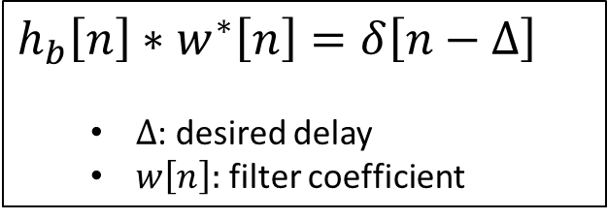
Equalizers For Frequency Selective Channel
Baseband Channel:
Slow fading ➔ Time invariant
Frequency-Selective fading (Multipath fading)
Equalizer Types:
Wiener filter
Zero forcing
LMS
$$h_{b}\left[n\right]∗w^{∗}\left[n\right]=δ\left[n−∆\right]$$
$∆$: desired delay
$w\left[n\right]:$ filter coefficient

Slide 3
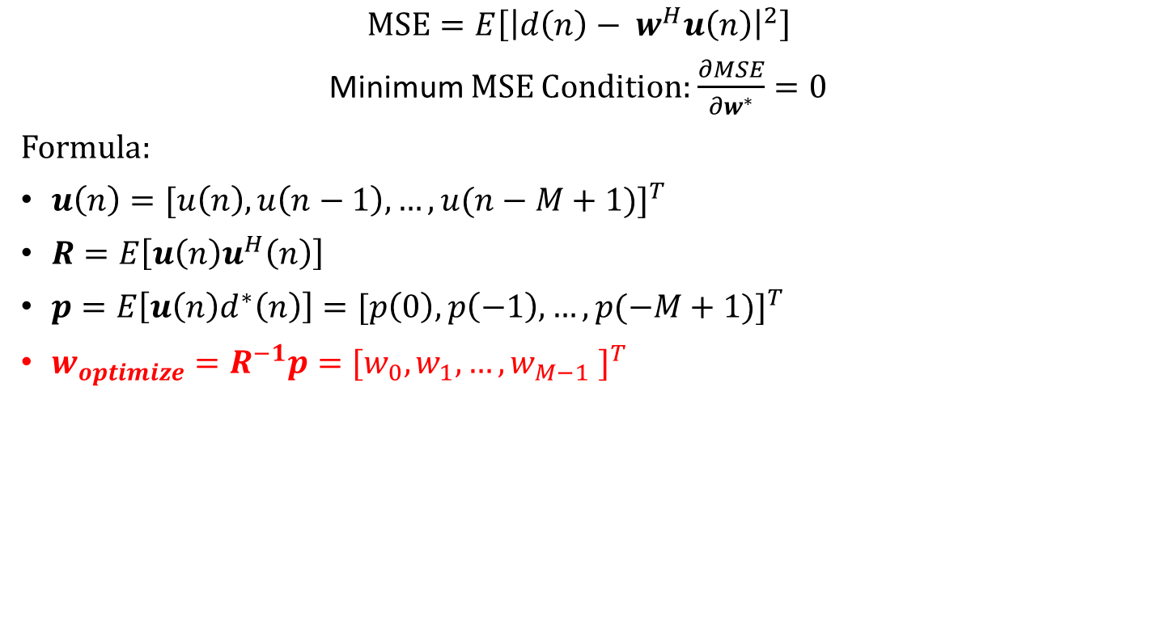
Wiener Filter
$$MSE=E\left[{\left|d\left(n\right)− w^{H}u\left(n\right)\right|}^{2}\right]$$
Minimum $MSE$ Condition: $\frac{∂MSE}{∂w^{∗}}=0$
Formula:
$u\left(n\right)={[u\left(n\right),u\left(n−1\right),…,u(n−M+1)]}^{T}$
$R=E\left[u\left(n\right)u^{H}\left(n\right)\right]$
$p=E\left[u\left(n\right)d^{∗}\left(n\right)\right]={[p\left(0\right),p\left(−1\right),…,p(−M+1)]}^{T}$
$w_{optimize}=R^{−1}p={[w_{0},w_{1},…,w_{M−1} ]}^{T}$

Slide 4
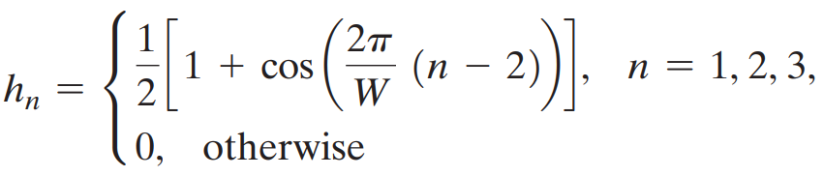
Wiener Filter
Channel impulse response:

Slide 5
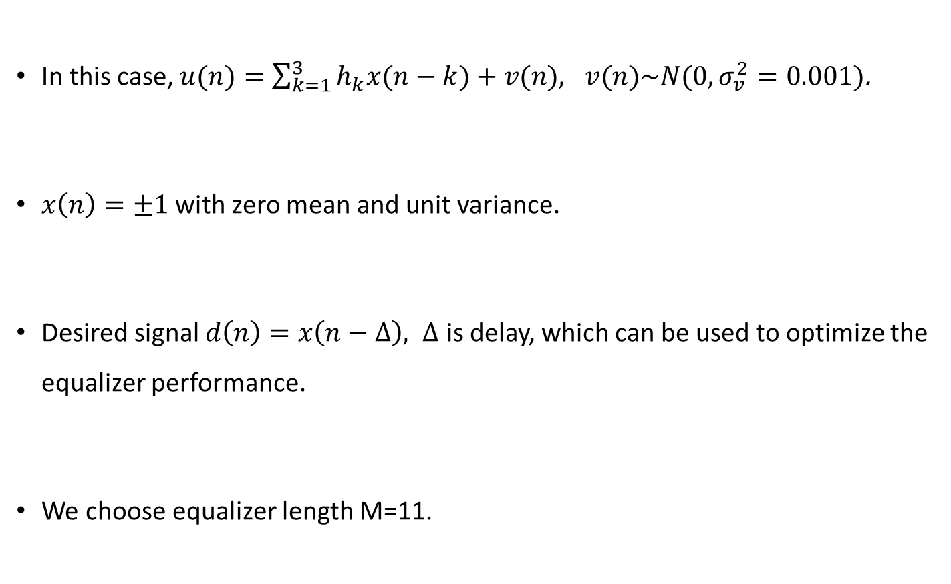
Wiener Filter
In this case, $u(n)=\sum_{k=1}^{3}{h_{k}x(n−k)+v(n), v(n)\sim N(0,σ_{v}^{2}=0.001)}$.
$x\left(n\right)=±1$ with zero mean and unit variance.
Desired signal $d\left(n\right)=x\left(n−∆\right), ∆$ is delay, which can be used to optimize the equalizer performance.
We choose equalizer length M=11.

Slide 6

Wiener Filter Mean Square Error
From the MSE diagram, we choose:
Delay $∆$ = 7

Slide 7

Optimum FIR equalizer
This result implies $h_{b}\left[n\right]∗w^{∗}\left[n\right]=δ\left[n−7\right]$

Slide 8

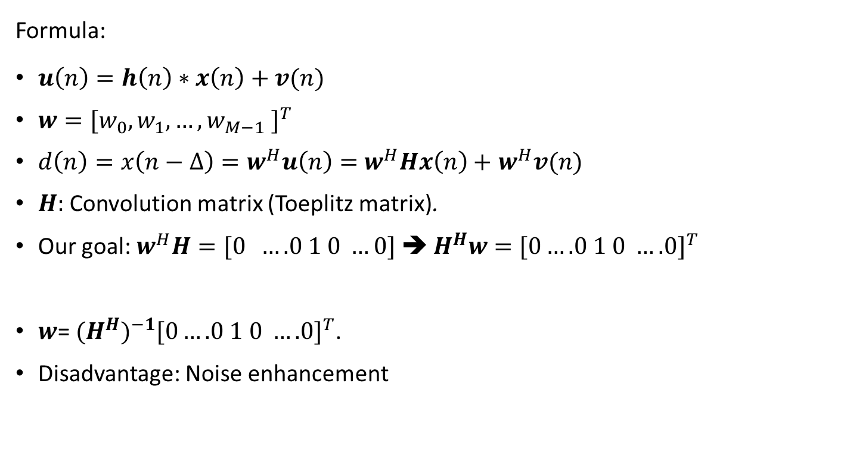
Zero forcing
Formula:
$u\left(n\right)=h\left(n\right)∗x\left(n\right)+v(n)$
$w={[w_{0},w_{1},…,w_{M−1} ]}^{T}$
$d\left(n\right)=x\left(n−∆\right)=w^{H}u\left(n\right)=$ $w^{H}Hx\left(n\right)+$ $w^{H}v(n)$
$H:$Convolution matrix (Toeplitz matrix).
Our goal: $w^{H}H=[0 ….0 1 0 …0]$ ➔ $H^{H}w=$ ${[0….0 1 0 ….0]}^{T}$
$w$= ${(H}^{H})^{−1}{[0….0 1 0 ….0]}^{T}$.
Disadvantage: Noise enhancement
Delay $∆$

Slide 9
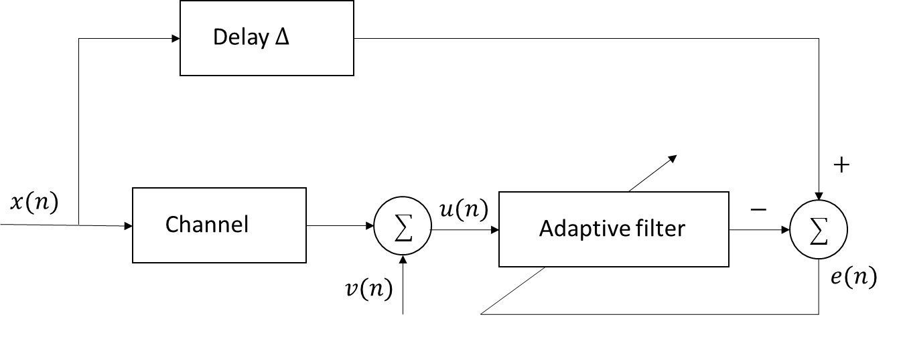
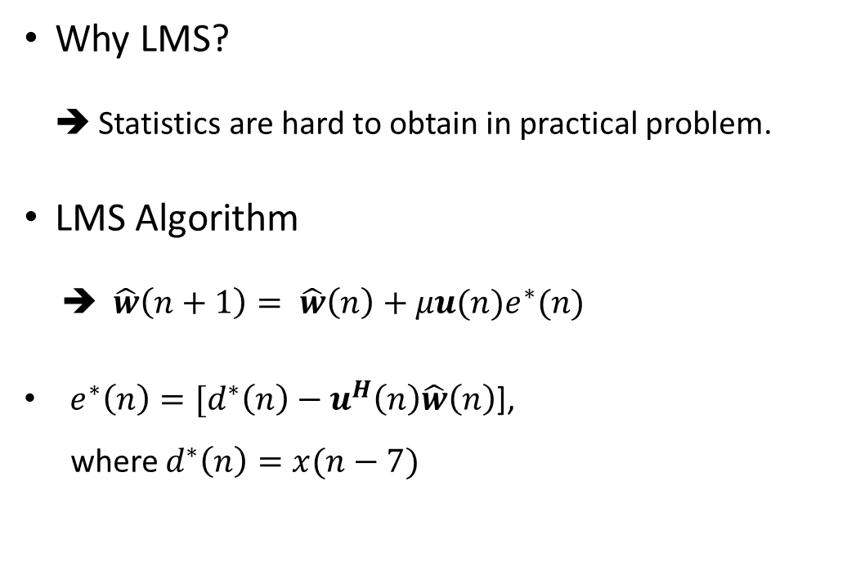
LMS Equalization
Why LMS?
➔ Statistics are hard to obtain in practical problem.
LMS Algorithm
➔ $\hat{w}\left(n+1\right)= \hat{w}\left(n\right)+μu(n)e^{∗}(n)$
$e^{∗}\left(n\right)=[d^{∗}\left(n\right)−u^{H}\left(n\right)\hat{w}\left(n\right)$],
where $d^{∗}\left(n\right)=x(n−7)$

Slide 10
Comparison

Slide 11
Comparison
LMS converges closer to Wiener solution in smaller step size case.
Zero-Forcing is worse than Wiener filter due to the noise enhancement.

Slide 12
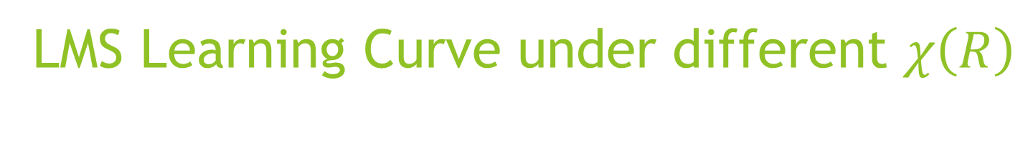
LMS Learning Curve under different $χ\left(R\right)$

Slide 13
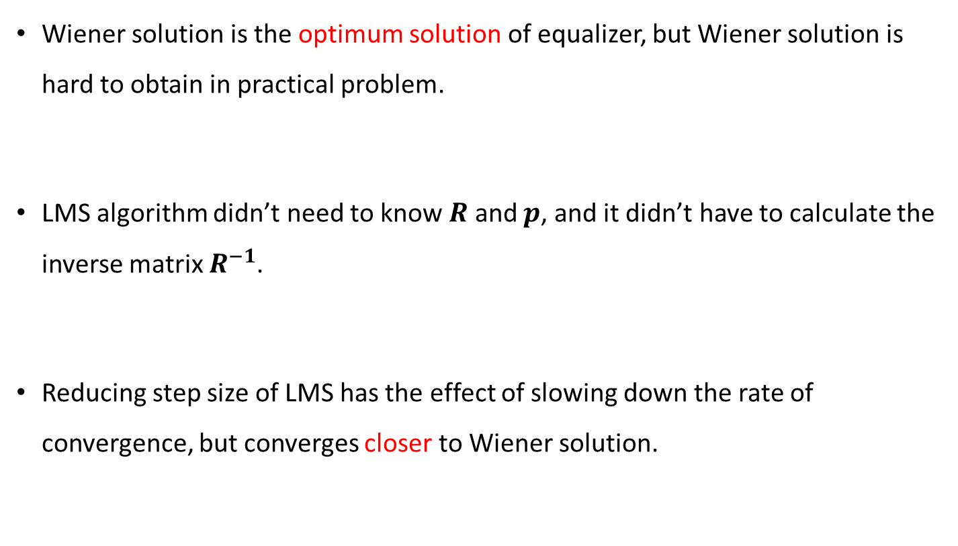
Conclusion
Wiener solution is the optimum solution of equalizer, but Wiener solution is hard to obtain in practical problem.
LMS algorithm didn’t need to know $R$ and $p$, and it didn’t have to calculate the inverse matrix $R^{−1}$.
Reducing step size of LMS has the effect of slowing down the rate of convergence, but converges closer to Wiener solution.

